Slide 1
Extracting Room Information from 2D Images
By Rob Dallara
April 29th, 2014

Slide 2
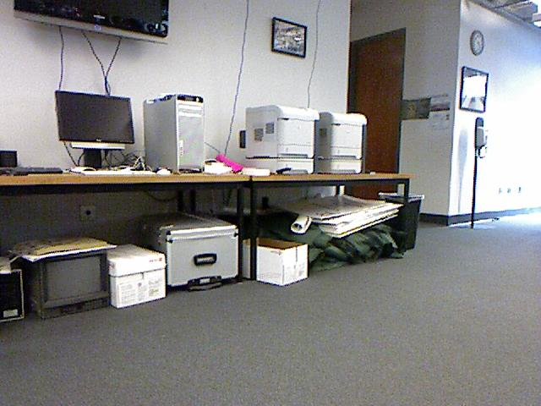
Basic Problem
Many robots must rely on visual sensors
Must often learn 3D information about environment from a single 2D image
Notes:
Image from page 1 of “Parsing Indoor Scenes Using RGB-D Imagery”, by C. J. Taylor and A. Cowley

Slide 3
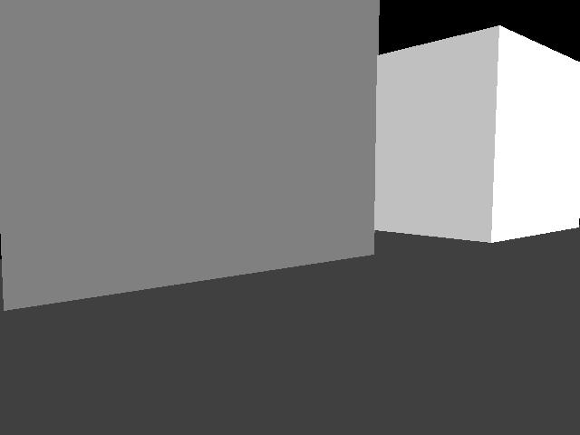
Project Goal
Extract basic wall layout from simple room images
Label different room planes (e.g. wall, floor) as accurately as possible
Notes:
Image from page 1 of “Parsing Indoor Scenes Using RGB-D Imagery”, by C. J. Taylor and A. Cowley

Slide 4
Algorithm
Smooth image to reduce/eliminate noise
Find candidate corner pixels based on changes in brightness across image
Smooth corner pixel data
Outline plane boundaries using linear regressions of corner pixels
Classify different planes using certain assumptions

Slide 5
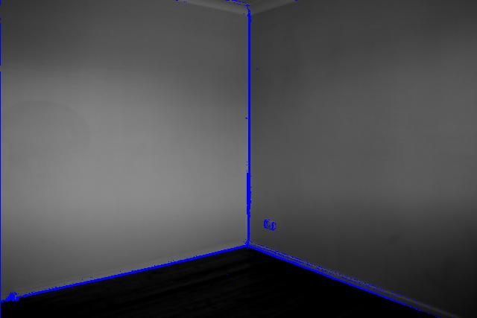
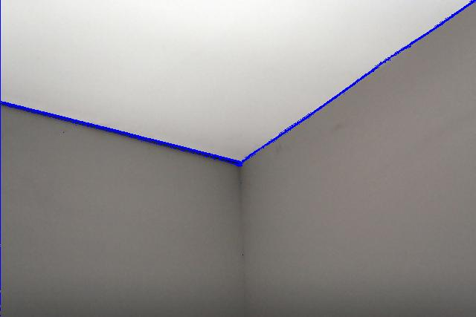
Wall Boundary Sampling Success
Notes:
Left image is based on image in the Flickr photo stream of “Evan Watson”: https://www.flickr.com/photos/evan144/
Right image is based on image in the Flickr photo stream of “Pulpolux !!!”: https://www.flickr.com/photos/pulpolux/

Slide 6
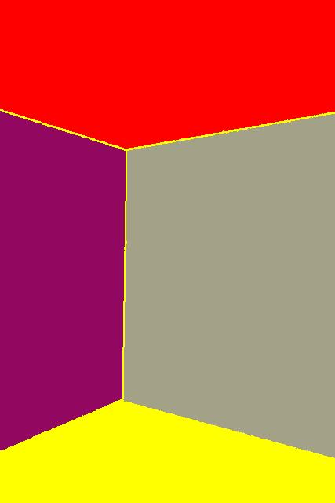

Region Labeling Success
Notes:
Left image is based on image in the Flickr photo stream of “Evan Watson”: https://www.flickr.com/photos/evan144/
Right image is based on image in the Flickr photo stream of “Pulpolux !!!”: https://www.flickr.com/photos/pulpolux/
*Note: red planes correspond to “ceiling” planes, yellow planes correspond to “floor” planes, and the wall planes are colored randomly.

Slide 7
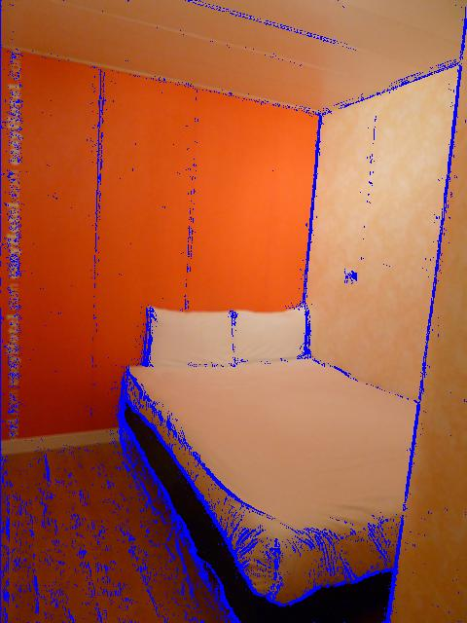
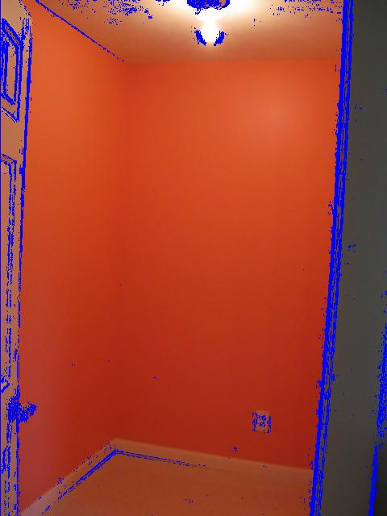
Wall Boundary Sampling Failure
Notes:
Left image is based on image in the Flickr photo stream of “givingnot@rocketmail.com“:https://www.flickr.com/photos/57474170@N05/
Right image is based on image in the Flickr photo stream of “Katrina Parks”: https://www.flickr.com/photos/kat1980/

Slide 8

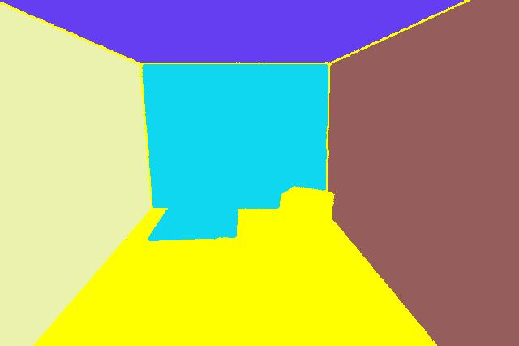
Region Labeling Failure
Notes:
Left image is based on image in the Flickr photo stream of “Louis Vest“: https://www.flickr.com/photos/oneeighteen/
Right image is based on image in the Flickr photo stream of “Katrina Parks”:: https://www.flickr.com/photos/kat1980/

Slide 9
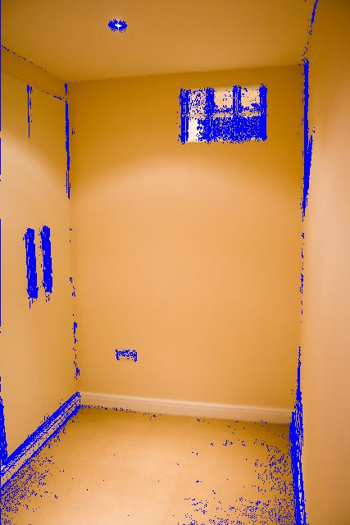
Limitations
Shadows and other noise limit accuracy of wall delineation
This, in turn, limits plane labeling accuracy
Notes:
Image is based on image in the Flickr photo stream of “YayAdrian”: https://www.flickr.com/photos/chegs/

Slide 10
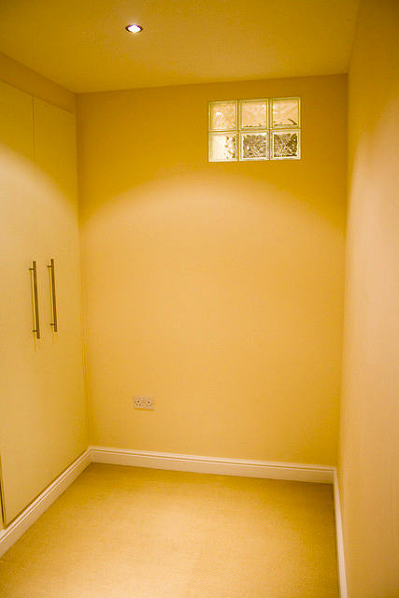
Conclusion
Room image analyzer is somewhat accurate, but still needs improvement
Image analysis is a challenging, but interesting problem which requires clever algorithms to implement
Notes:
Image is based on image in the Flickr photo stream of “YayAdrian”: https://www.flickr.com/photos/chegs/

Slide 11
Future Work
Improving algorithm to deal with shadows for greater corner accuracy
Smarter, perhaps probabilistic algorithms to better label floor, walls, and ceiling

Slide 12
Questions?

Slide 13
Thank you!

